Slide 1
Sorting Algorithms
Data Structures

Slide 2
Sorting in Databases
Many possibilities
  Names in alphabetical order
  Students by grade
  Customers by zip code
  Home sales by price
  Cities by population
  Stars by magnitude

Slide 3
Sorting and Searching
We saw with arrays they could work in tandem to improve speed
What was the search method that required sorting an array?
How much faster was the search?
But that means nothing if sorting takes forever!
  For this and its usefulness, sorting algorithms have been heavily researched

Slide 4
Basic Sorting Algorithms
Bubble
Selection
Insertion
Although these are:
  Simpler
  Slower
They sometimes are better than advanced
And sometimes the advanced methods build on them

Slide 5


Example
Unordered:
Ordered:
Of course, a computer doesn’t have the luxuries we have…

Slide 6
Simple Sorts
All three algorithms involve two basic steps, which are executed repeatedly until the data is sorted
  Compare two items
  Either (1) swap two items, or copy one item
They differ in the details and order of operations

Slide 7
Sort #1: The Bubble Sort
Way to envision:
  Suppose you’re ‘near sighted’
  You can only see two adjacent players at the same time
  How would you sort them?
This is how a bubble sort works!
  1. Start at position i=0
  2. Compare position i and i+1
  3. If the player at position i is taller than the one at i+1, swap
  4. Move one position right

Slide 8
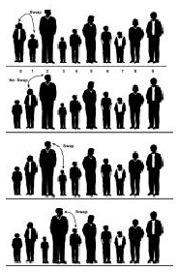
Bubble Sort: First Pass

Slide 9

Bubble Sort: End of First Pass
Note: Now the tallest person must be on the end
  Why?
Do we understand the name ‘bubble sort’ now?

Slide 10
Count Operations
First Pass, for an array of size n:
  How many comparisons were made?
  How many (worst case) swaps were made?
Now we have to start again at zero and do the same thing
  Compare
  Swap if appropriate
  Move to the right
  But this time, we can stop one short (why?)
Keep doing this until all players are in order

Slide 11
Let’s do an example ourselves…
Use a bubble sort to sort an array of ten integers:
30 45 8 204 165 95 28 180 110 40

Slide 12
How many operations total then?
First pass: n-1 comparisons, n-1 swaps
Second pass: n-2 comparisons, n-2 swaps
Third pass: n-3 comparisons, n-3 swaps
(n-1)th pass: 1 comparison, 1 swap
Then it’s sorted
So we have (worst case):
  (n-1)+(n-2)+….+1 comparisons = n(n+1)/2 = 0.5(n²+n)
  (n-1)+(n-2)+….+1 comparisons = n(n+1)/2 = 0.5(n²+n)
Total: 2*(0.5(n²+n)) = n²+n = O(n²)

Slide 13
Java Implementation
Let’s go through the example together on page 85
Zero in on the bubble sort method
  Note how simple it is (4 lines)!
  Also note: the outer loop goes backwards!
    Why is this more convenient? Look where else this loop counter is used.
We also have a function for swapping
  What’s good about this?
  What’s bad?

Slide 14
Invariants
Algorithms tend to have invariants, i.e. facts which are true all the time throughout its execution
In the case of the bubble sort, what is always true is….
Worth thinking about when trying to understand algorithms

Slide 15
Sort #2: Selection Sort
Purpose:
  Improve the speed of the bubble sort
  Number of comparisons: O(n²)
  Number of swaps: O(n)
We’ll go back to the baseball team…
  Now, we no longer compare only players next to each other
  Rather, we must ‘remember’ heights
  So what’s another tradeoff of selection sort?

Slide 16
What’s Involved
Make a pass through all the players
  Find the shortest one
Swap that one with the player at the left of the line
  At position 0
Now the leftmost is sorted
Find the shortest of the remaining (n-1) players
Swap that one with the player at position 1
And so on and so forth…

Slide 17
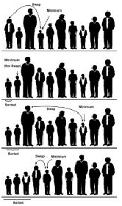
Selection Sort in Action

Slide 18
Count Operations
First Pass, for an array of size n:
  How many comparisons were made?
  How many (worst case) swaps were made?
Now we have to start again at position one and do the same thing
  Find the smallest
  Swap with position one
Keep doing this until all players are in order

Slide 19
Let’s do an example ourselves…
Use a selection sort to sort an array of ten integers:
30 45 8 204 165 95 28 180 110 40

Slide 20
How many operations total then?
First pass: n-1 comparisons, 1 swap
Second pass: n-2 comparisons, 1 swap
Third pass: n-3 comparisons, 1 swap
(n-1)th pass: 1 comparison, 1 swap
Then it’s sorted
So we have (worst case):
  (n-1)+(n-2)+….+1 comparisons = n(n-1)/2 = 0.5(n² - n)
  1+1+….+1 comparisons = n-1
Total: 0.5(n² - n) + (n – 1) = 0.5n² + 0.5n - 1 = O(n²)

Slide 21
Implementation – page 92
Let’s go through the function together.
Things to watch:
  A bit more complex than bubble (6 lines)
  A bit more memory (one extra integer)

Slide 22
A method of an array class…
See page 93, we’ll go through it.

Slide 23
Sort #3: Insertion Sort
In most cases, the best one…
  2x as fast as bubble sort
  Somewhat faster than selection in MOST cases
Slightly more complex than the other two
More advanced algorithms (quicksort) use it as a stage

Slide 24
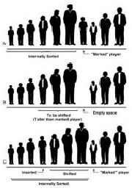
Proceed..
A subarray to the left is ‘partially sorted’
  Start with the first element
The player immediately to the right is ‘marked’.
The ‘marked’ player is inserted into the correct place in the partially sorted array
  Remove first
  Marked player ‘walks’ to the left
  Shift appropriate elements until we hit a smaller one

Slide 25
Let’s do an example ourselves…
Use a insertion sort to sort an array of ten integers:
30 45 8 204 165 95 28 180 110 40

Slide 26
Count Operations
First Pass, for an array of size n:
  How many comparisons were made?
  How many swaps were made?
    Were there any? What were there?
Now we have to start again at position two and do the same thing
  Move the marked player to the correct spot
Keep doing this until all players are in order

Slide 27
How many operations total then?
First pass: 1 comparison, 1 copy
Second pass: 2 comparisons, 2 copies
Third pass: 3 comparisons, 3 copies
(n-1)th pass: n-1 comparison, n-1 copies
Then it’s sorted
So we have (worst case):
  (n-1)+(n-2)+….+1 comparisons = n(n-1)/2 = 0.5(n²- n)
  (n-1)+(n-2)+….+1 copies = n(n-1)/2 = 0.5(n²- n)
Total: 2*(0.5(n²+n)) = n²- n = O(n²)

Slide 28
Why are we claiming it’s better than selection sort?
A swap is an expensive operation. A copy is not.
  To see this, how many copies are required per swap?
  Selection/bubble used swaps, insertion used copies.
Secondly, if an array is sorted or almost sorted, insertion sort runs in approximately O(n) time. Why is that?
  How many comparisons would you need per iteration? And how many copies?
  Bubble and selection would require O(n²) comparisons even if the array was completely sorted initially!

Slide 29
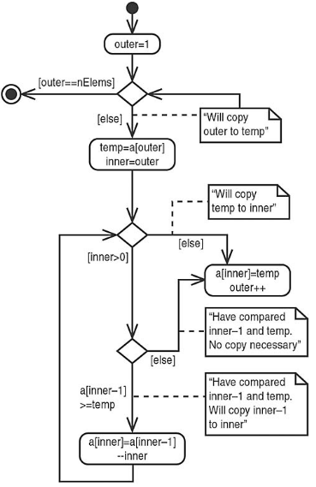
Flow

Slide 30
Implementation
We’ll write the function (pages 99-100) together
Use the control flow on the previous slide

Slide 31
And finally…
Encapsulate the functionality within an array class (p. 101-102)

Slide 32
Invariant of Insertion Sort
At the end of each pass, the data items with indices smaller than __________ are partially sorted.

Slide 33
Sorting Objects
Let’s modify our insertion sort to work on a Person class, which has three private data members:
  lastName (String)
  firstName (String)
  age (int)
What do we need for something like insertion sort to work?
How do we define that?

Slide 34
Lexicographic Comparison
For Java Strings, you can lexicographically compare them through method compareTo():
  s1.compareTo(s2);
  Returns an integer
  If s1 comes before s2 lexicographically, returns a value < 0
  If s1 is the same as s2, return 0
  If s1 comes after s2 lexicographically, returns a value > 0

Slide 35
Stable Object Sorts
Suppose you can have multiple persons with the same last name.
  Now given this ordering, sort by something else (first name)
A stable sort retains the first ordering when the second sort executes.
All three of these sorts (bubble, selection, insertion) are stable.

Slide 36
Sort Comparison: Summary
Bubble Sort – hardly ever used
  Too slow, unless data is very small
Selection Sort – slightly better
  Useful if: data is quite small and swapping is time-consuming compared to comparisons
Insertion Sort – most versatile
  Best in most situations
  Still for large amounts of highly unsorted data, there are better ways – we’ll look at them
Memory requirements are not high for any of these

